Slide 1
Combinational Circuits
Mr. Bikash Kumar Behera

Slide 2
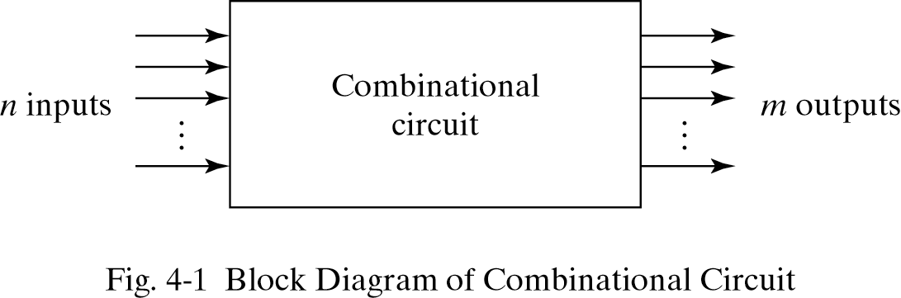
Combinational Logic
Logic circuits for digital systems may be combinational or sequential.
A combinational circuit consists of input variables, logic gates, and output variables.
The outputs are functions of inputs.

Slide 3
Design Procedure
From the pspecifications of the circuit determine the required number of inputs and outputs and assign a symbol to each.
Derive the truth table that defines the required relationship between inputs and outputs.
Obtain the simplified Boolean functions for each output as a function of the input variables using K-Map.
Draw the logic diagram.

Slide 4
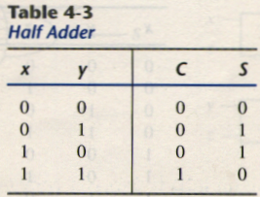
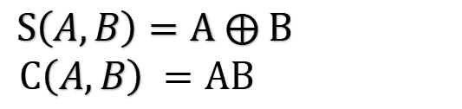
Half Adder
A combinational circuit that performs the addition of two bits is called a half adder.
The truth table for the half adder is listed below:
A B C S
$S\left(A,B\right)=A ⨁ B$
$$C\left(A,B\right) =AB$$

Slide 5
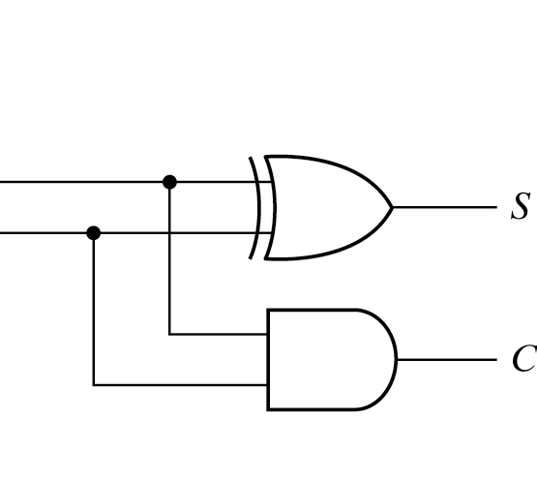
Half Adder
A
B
$S\left(A,B\right)=A ⨁ B$
$$C\left(A,B\right) =AB$$

Slide 6
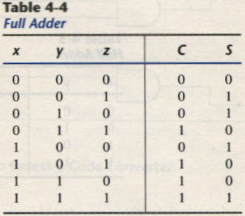
Full-Adder
One that performs the addition of three bits(two significant bits and a previous carry) is a full adder.
A B C_{in} C_{out} S

Slide 7
Full Adder
BC_{in}
A
BC_{in}
A
C_{out}

Slide 8
Full Adder
A
B
C_{in}
Sum
C_{out}

Slide 9

Half Subtractor
Half Subtractor is a combinational logic circuit.
It is used for the purpose of subtracting two single bit numbers.
It contains 2 inputs and 2 outputs (difference and borrow).
X | Y | Difference(D) | Borrow(B)
0 | 0 | 0 | 0
0 | 1 | 1 | 1
1 | 0 | 1 | 0
1 | 1 | 0 | 0

Slide 10
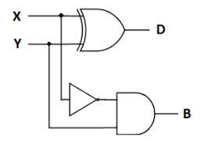
Half Subtractor

Slide 11
Full Subtractor
Full Subtractor is a combinational logic circuit.
Thus, full subtractor has the ability to perform the subtraction of three bits.
Full subtractor contains 3 inputs and 2 outputs (Difference and Borrow)

Slide 12
Full Subtractor
X | Y | Z | Difference(D) | Borrow(B)
0 | 0 | 0 | 0 | 0
0 | 0 | 1 | 1 | 1
0 | 1 | 0 | 1 | 1
0 | 1 | 1 | 0 | 1
1 | 0 | 0 | 1 | 0
1 | 0 | 1 | 0 | 0
1 | 1 | 0 | 0 | 0
1 | 1 | 1 | 1 | 1

Slide 13
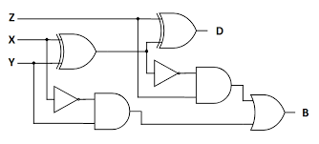
Full Subtractor

Slide 14
Full Subtractor
Difference = Z ⊕(X ⊕Y)
Borrow = X'Y + (X ⊕Y)' Z

Slide 15
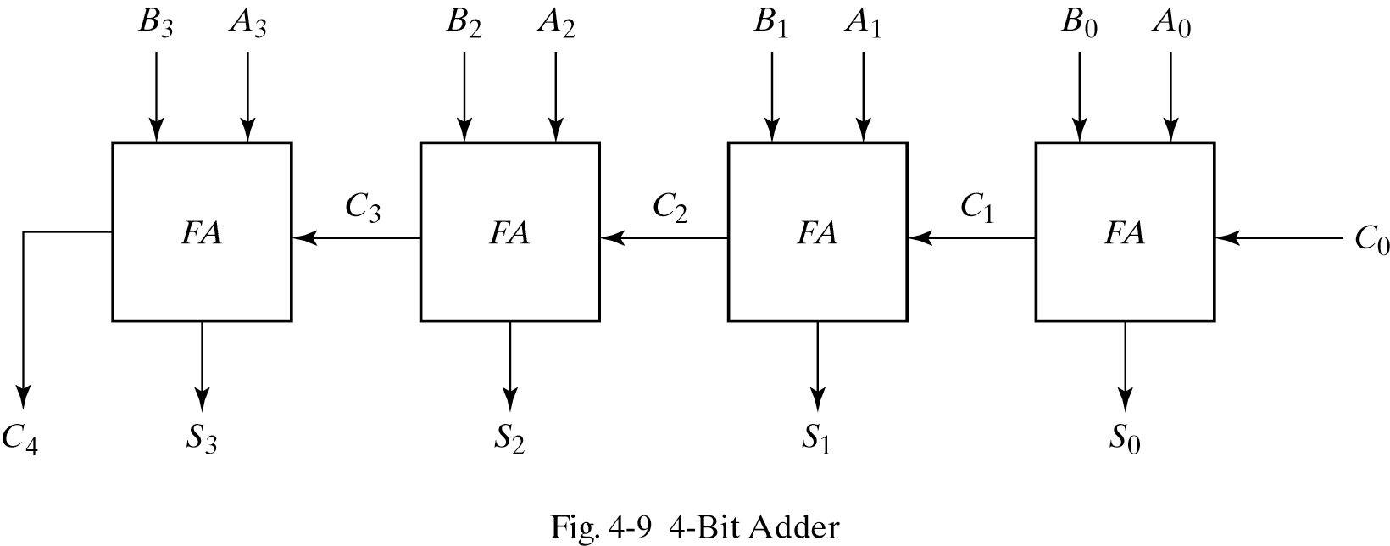
Binary adder
This is also called Ripple Carry Adder ,because of the construction with full adders are connected in cascade.

Slide 16
Carry Propagation
The signal from C_{i} to the output carry C_{i+1}, propagates through an AND and OR gates, so, for an n-bit RCA, there are 2n gate levels for the carry to propagate from input to output.
Because the propagation delay will affect the output signals on different time, so the signals are given enough time to get the precise and stable outputs.

Slide 17
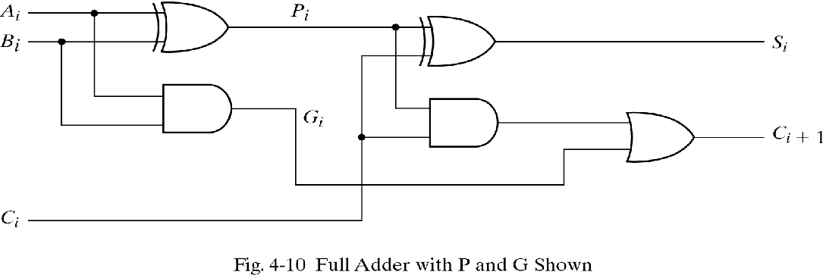
Carry look-ahead Adder

Slide 18
Carry look-ahead Adder
P_{i} = A_{i} ⊕ B_{i} Carry Propagating term
G_{i} = A_{i}B_{i} Carry Generating term
Output sum and carry
S_{i} = P_{i} ⊕ C_{i}
C_{i+1} = G_{i} + P_{i}C_{i}
G_{i} : carry generate P_{i} : carry propagate
C₀ = input carry
C₁ = G₀ + P₀C₀
C₂ = G₁ + P₁C₁ = G₁ + P₁G₀ + P₁P₀C₀
C₃ = G₂ + P₂C₂ = G₂ + P₂G₁ + P₂P₁G₀ + P₂P₁P₀C₀
C₃ does not have to wait for C₂ and C₁ to propagate.

Slide 19
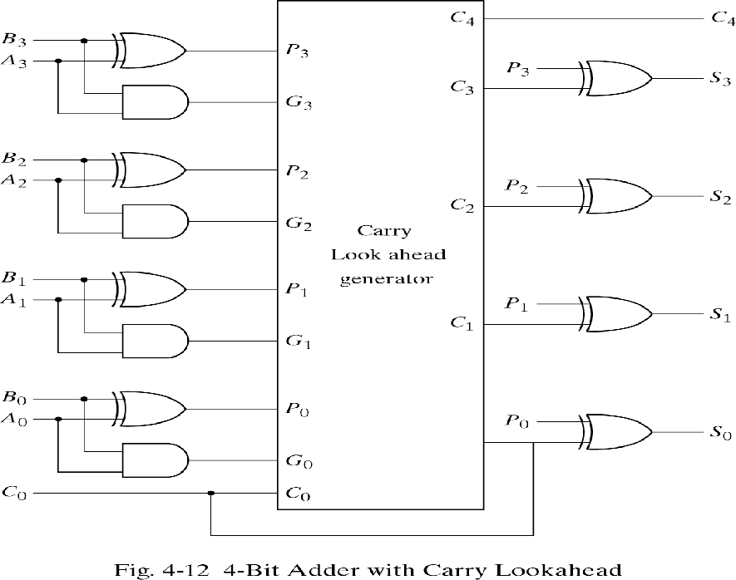
4-bit adder with carry lookahead

Slide 20
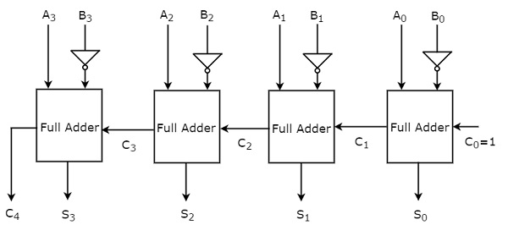
Binary Subtractor

Slide 21
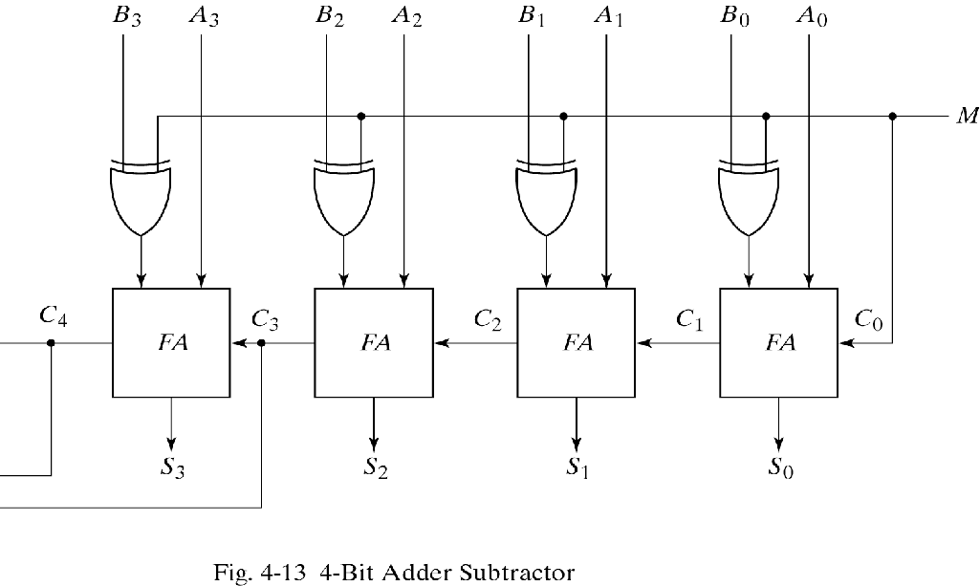
Binary Adder/Subtractor
M = 1→subtractor and M = 0→adder

Slide 22
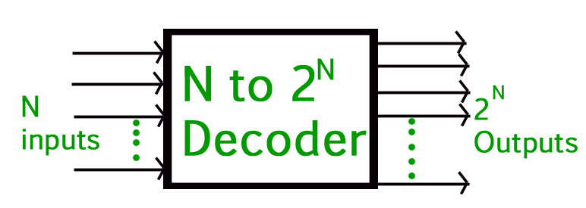
Decoder
Decoder is a combinational circuit that has ‘N’ input lines and maximum of (2)^{N} unique output lines.
The name “Decoder” means to translate or decode coded information from one format into another, so a digital decoder transforms a set of digital input signals into an equivalent decimal code at its output.

Slide 23
Decoder
Active High Decoder - The output line that is active will be High(1) and rest all the outputs will be low(0).
Active Low Decoder - The output line that is active will be Low(0) and rest all the outputs will be High(1).

Slide 24
2:4 active high Decoder Decoder Basics and 2 to 4 Decodee
I₁ | I₀ | D₀ | D₁ | D₂ | D₃
0 | 0 | 1 | 0 | 0 | 0
0 | 1 | 0 | 1 | 0 | 0
1 | 0 | 0 | 0 | 1 | 0
1 | 1 | 0 | 0 | 0 | 1

Slide 25
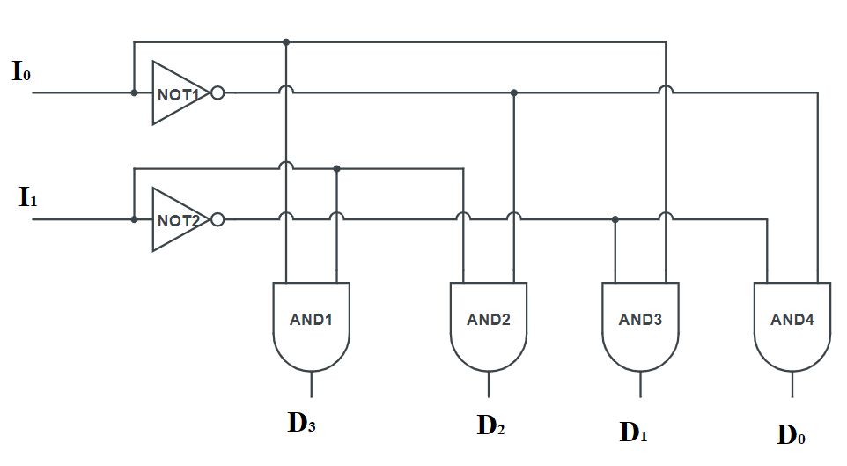
2:4 active high Decoder

Slide 26
2:4 active low Decoder
I₁ | I₀ | D₀ | D₁ | D₂ | D₃
0 | 0 | 0 | 1 | 1 | 1
0 | 1 | 1 | 0 | 1 | 1
1 | 0 | 1 | 1 | 0 | 1
1 | 1 | 1 | 1 | 1 | 0

Slide 27
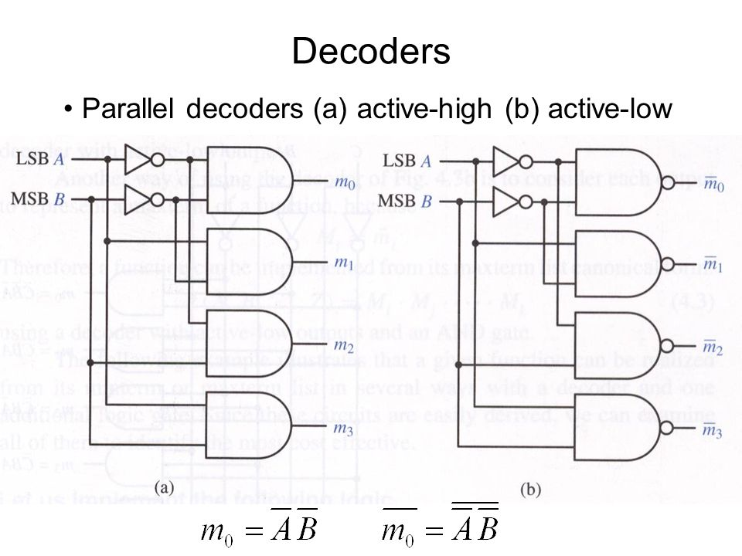
2:4 active low Decoder
I₀
D₀
I₁
D₁
D₂
D₃

Slide 28
3:8 line Decoder 3 to 8 Decoder workinge
I₂ | I₁ | I₀ | D₀ | D₁ | D₂ | D₃ | D₄ | D₅ | D₆ | D₇
0 | 0 | 0 | 1 | 0 | 0 | 0 | 0 | 0 | 0 | 0
0 | 0 | 1 | 0 | 1 | 0 | 0 | 0 | 0 | 0 | 0
0 | 1 | 0 | 0 | 0 | 1 | 0 | 0 | 0 | 0 | 0
0 | 1 | 1 | 0 | 0 | 0 | 1 | 0 | 0 | 0 | 0
1 | 0 | 0 | 0 | 0 | 0 | 0 | 1 | 0 | 0 | 0
1 | 0 | 1 | 0 | 0 | 0 | 0 | 0 | 1 |  | 0
1 | 1 | 0 | 0 | 0 | 0 | 0 | 0 | 0 | 1 | 0
1 | 1 | 1 | 0 | 0 | 0 | 0 | 0 | 0 | 0 | 1

Slide 29
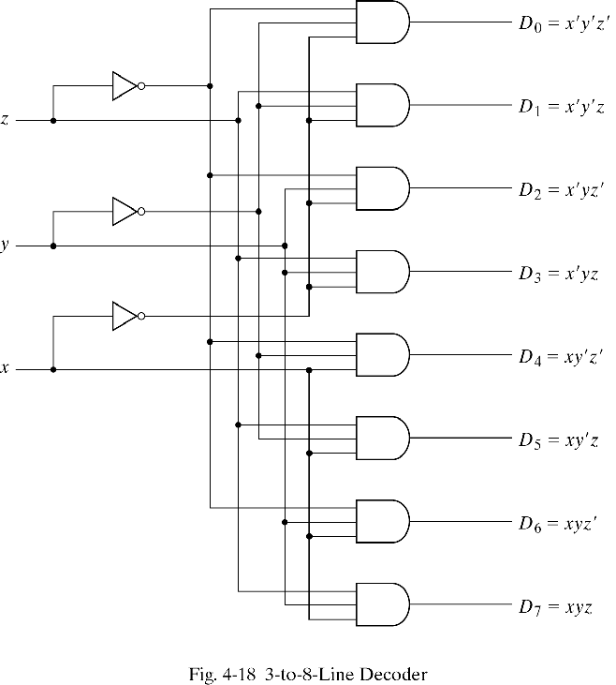
3:8 line Decoder
I₀
I₁
I₂

Slide 30
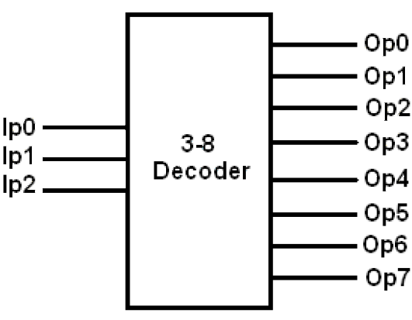
Block diagram of 3:8 active high decoder
D₀
D₁
I₂
D₂
D₃
I₁
D₄
I₀
D₅
D₆
D₇

Slide 31
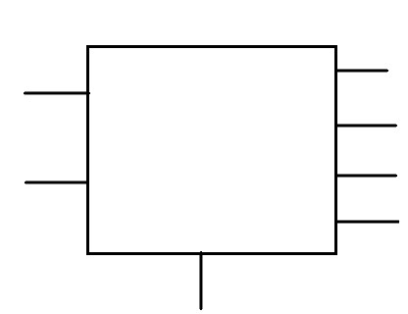
2:4 Active High Decoder with Enable High
E | I₁ | I₀ | D₀ | D₁ | D₂ | D₃
0 | X | X | 0 | 0 | 0 | 0
1 | 0 | 0 | 0 | 1 | 1 | 1
1 | 0 | 1 | 1 | 0 | 1 | 1
1 | 1 | 0 | 1 | 1 | 0 | 1
1 | 1 | 1 | 1 | 1 | 1 | 0
D₀
I₁
D₁
D₂
I₀
D₃
E

Slide 32
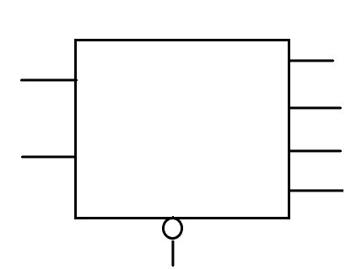

2:4 Active High Decoder with Enable Low
E | I₁ | I₀ | D₀ | D₁ | D₂ | D₃
0 | 0 | 0 | 0 | 1 | 1 | 1
0 | 0 | 1 | 1 | 0 | 1 | 1
0 | 1 | 0 | 1 | 1 | 0 | 1
0 | 1 | 1 | 1 | 1 | 1 | 0
1 | X | X | 0 | 0 | 0 | 0
D₀
I₁
D₁
I₀
D₂
$$\overline{E}$$
D₃

Slide 33
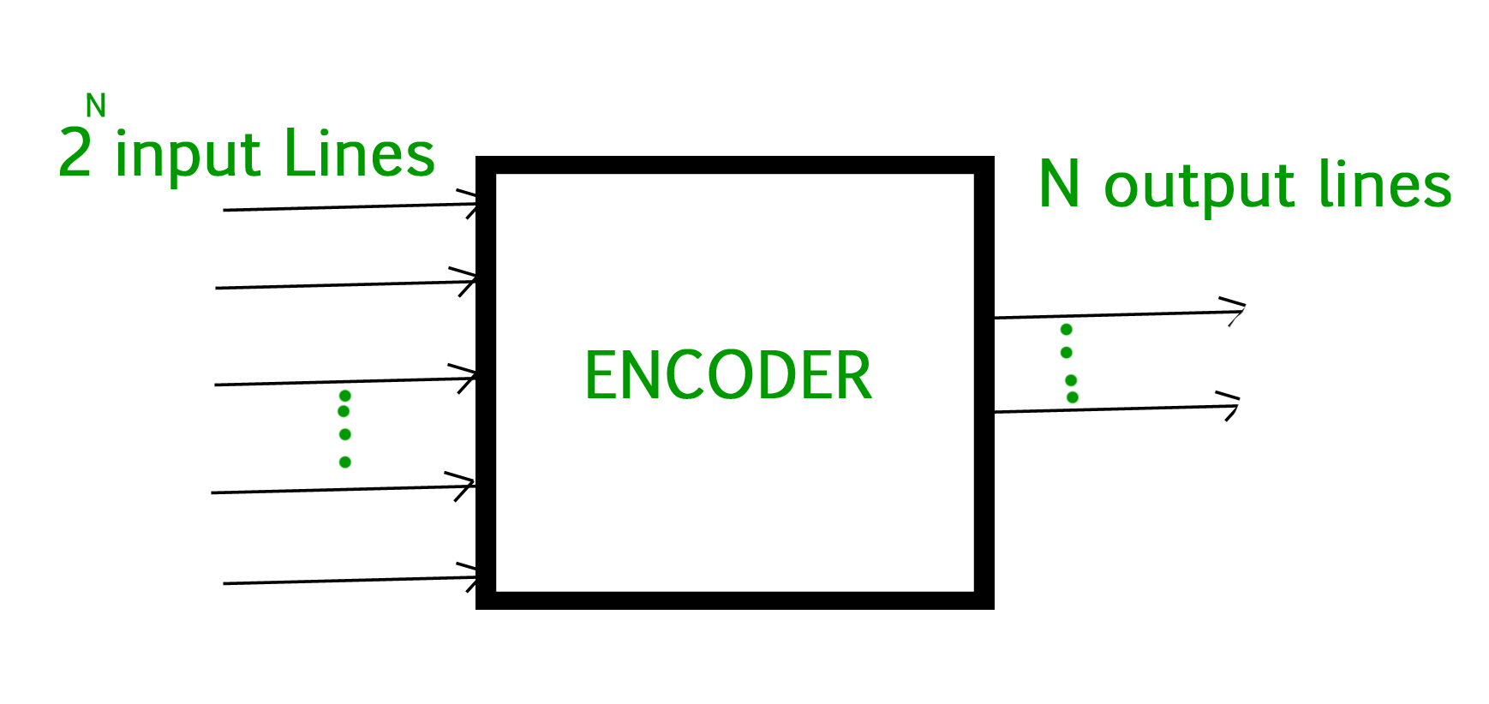
Encoder Encoder in Digital Electronicse
An encoder is the inverse operation of a decoder.
It Converts Decimal to Binary.
At any instant of time only input line should be active.

Slide 34
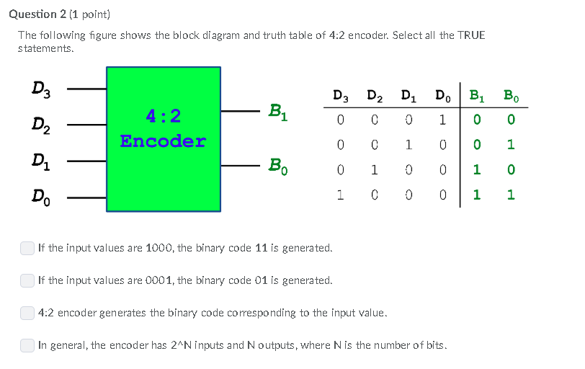
4:2 Encoder

Slide 35
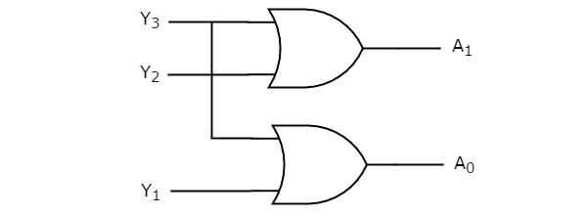
4:2 Encoder
D₃
B₁
D₂
B₀
D₁

Slide 36
Multiplexer/ Data Selector Multiplexer 2*1, 4:2
Multiplexer is a combinational circuit that has maximum of (2)^{n}data inputs, ‘n’ selection lines and single output line.
One of these data inputs will be connected to the output based on the values of selection lines.
Since there are ‘n’ selection lines, there will be (2)^{n} possible combinations of zeros and ones.
So, each combination will select only one data input.

Slide 37
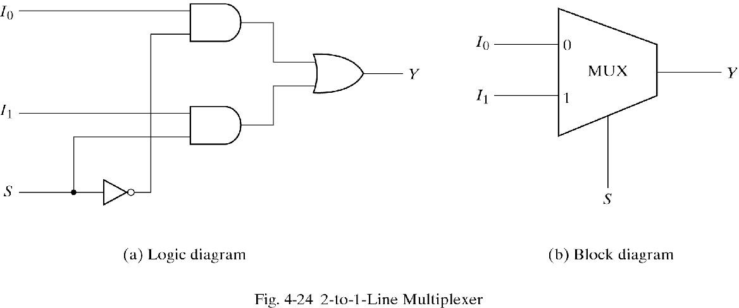
2X1 Multiplexer
Function Table
S | F
0 | I₀
1 | I₁
Truth Table
S | I₁ | I₀ | F
0 | 0 | 0 | 0
0 | 0 | 1 | 1
0 | 1 | 0 | 0
0 | 1 | 1 | 1
1 | 0 | 0 | 0
1 | 0 | 1 | 0
1 | 1 | 0 | 1
1 | 1 | 1 | 1

Slide 38
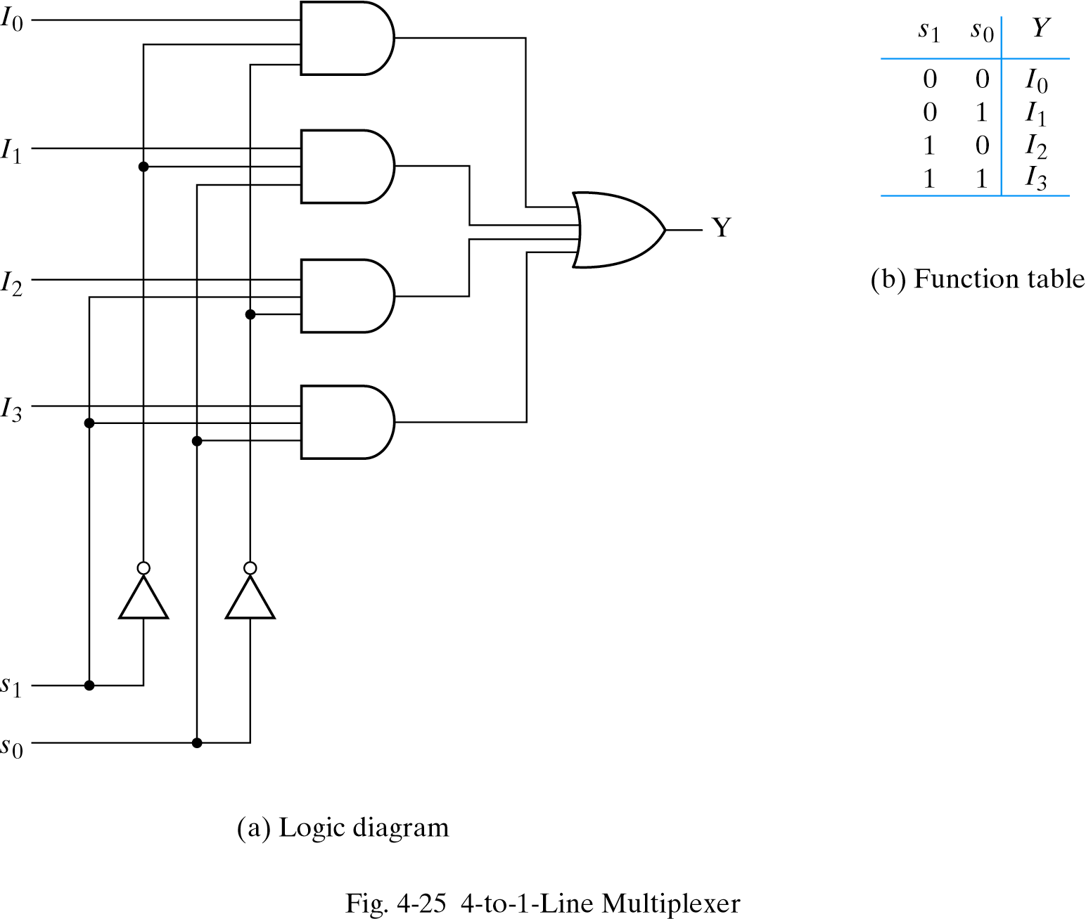
4X1 Multiplexer
Function Table
S₁ | S₀ | F
0 | 0 | I₀
0 | 1 | I₁
1 | 0 | I₂
1 | 1 | I₃
F

Slide 39
Boolean Function Implementation
The inividual minterms can be selected by the data inputs thereby providing a method of implementing a Boolean function of n variables with a multiplexer that has “n” selection inputs and “2^{n”} data inputs one for each minterm .
The minterm of a function are generated in a multiplexer by the circuit associated with the selection inputs.
For implementing any Boolean function of “n” variables with a multiplexer with “(n-1)” selection inputs and “2^{(n-1)”} data inputs follows from the previous example . To begin with, Boolean function is listed in a truth table. Then first “(n-1)” variables in the table are applied to the selection inputs of the multiplexer
Implementation of Boolean Function in Multiplexer | Solved problem – YouTube
Demultiplexer (DEMUX) Digital Decoder | 1 to 4 Demultiplexer | Full Adder using Demux - YouTube

